Slide 1

Sign Language to Text & Speech Conversion
Presented By:
ABHINAV (20168013)
AAKARSH VERMA (20168002)
ABHISHEK DIXIT (20168004) MANOJ MAHAUR (20158048)
Under the guidance of
Er. MANOJ WAIRIYA
Computer Science & Engineering Department
Motilal Nehru National Institute of Technology Allahabad, Prayagraj

Slide 2
Contents
Introduction
Problem Statement
Solution
Methodology
Sequence of operations
Demo
Applications
Limitations
Future Scope
References

Slide 3
Introduction
Today there are almost 2 million people classified as deaf and dumb.
People with hearing and speaking disability have to learn sign language to listen to others and to be heard by others.
It is very difficult for people with hearing and speaking complications to communicate and express themselves to normal people.
They require a third person as translator who knows sign language.

Slide 4

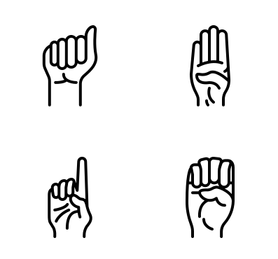

Problem Statement
Sign Language
Normal Individual
Deaf-Mute Individual
Human Translator
To bridge the communication gap between normal and deaf-mute individual by providing an automatic translation system.

Slide 5

Solution
Sign
Language
Translation System
Normal Individual
Deaf-Mute Individual
+
To make a sign language recognition and translation system that seamlessly converts sign language to text and speech.
To detect hand gestures from camera and classify them into English phrases.
To classify hand gestures based on sensor data received from stress sensors attached on a wearable glove.

Slide 6
Methodology
Image Processing
Deep Learning (CNN)

Slide 7


Image Processing
Used OpenCV to create hand histogram, to separate hand gestures from the background.
The processed frame is then fed to the CNN model that predicts the output.

Slide 8

Convolutional Neural Network
We used Keras, a python framework to implement our Deep Learning Model.
Dataset consisted of 24,000 gray scale images (50x50) for each class.
Our CNN model consists 5 layers (3 convolutional layers, 2 fully connected layers)

Slide 9
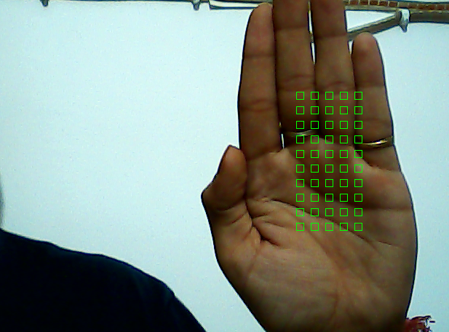
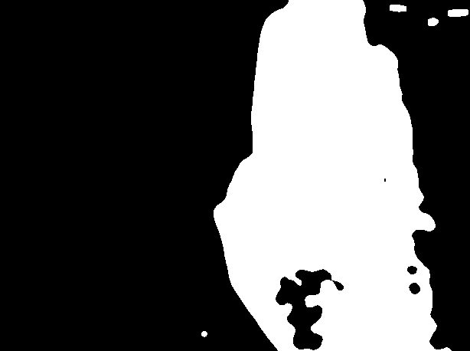
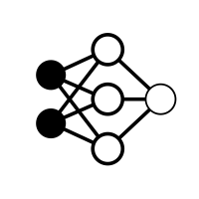
Sequence of Operations
B
Identified Symbol
Hand Gesture
Histogram
CNN

Slide 10
DEMO (SOFTWARE)

Slide 11
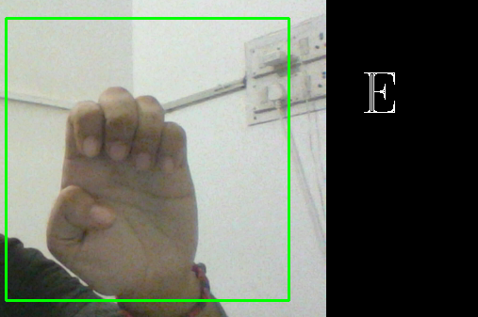
Software in working

Slide 12
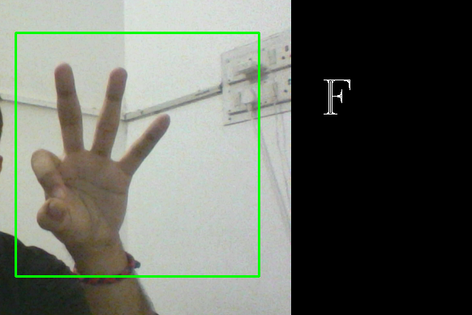
Translating to Single Characters

Slide 13
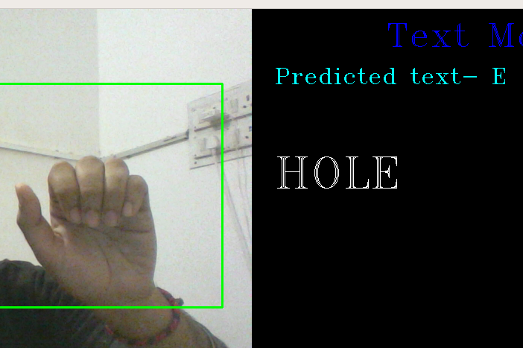
Concatenation of Characters

Slide 14
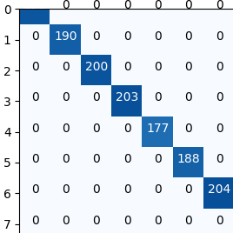
Results
Confusion Matrix: It is used to describe the performance of the classifying model. The higher th diagonal value, the better is the model.

Slide 15
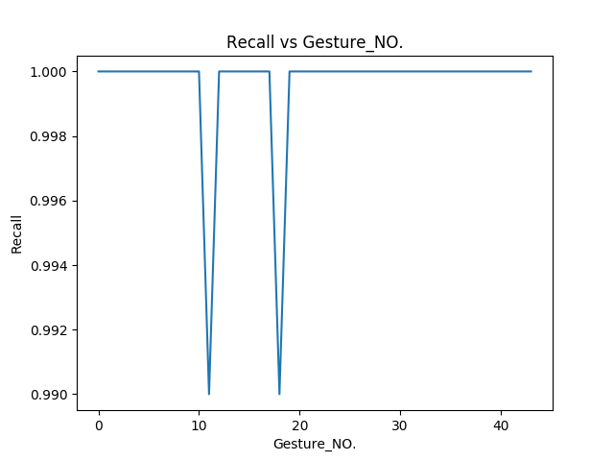
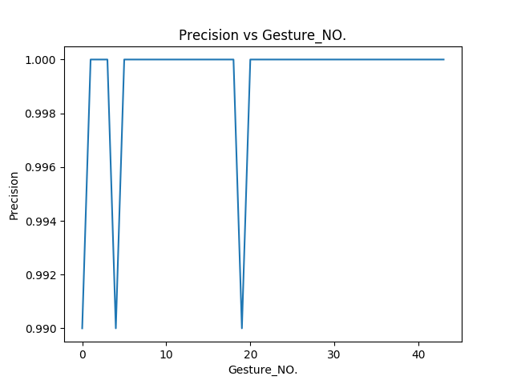
2. Recall: It is the fraction of the total number of relevant instances that were retrieved.
Recall=TP/(TP+FN)
3. Precision: It is deﬁned as the fraction of the relevant instances among the instances retrieved.
Precision=TP/(TP+FP)

Slide 16
Applications
Deaf and Dumb people will be able to convey their thoughts with hand gestures without the need of a translator.
Can be used to detect any kind of threat where sign language is being used to communicate, by analysing the suspected gestures.
Sensor based glove can work even in dark and areas with high noise images.

Slide 17
Limitations
System will fail to work in accelerated motions.
Image processing based implementation would fail in dark and when background is very similar to skin color.
Complicated gestures involving motion cannot be identified.

Slide 18
Future Scope
Adjustment to count for system in motion.
Converting the gestures into speech as well.
Conversion of normal text into gestures for an effective 2-way communication.
Identify complicated gestures involving two hands and motion.
Use hand gestures to control and automate other devices.

Slide 19
References
Anuja V.Nair, Bindu.V, “A Review on Indian Sign Language Recognition”, International journal of computer applications, Vol. 73, pp: 22, (2013).
Meenakshi Panwar, “Hand Gesture Recognition based on Shape Parameters” International Conference on Computing, Communication and Application (ICCCA), pp: I-6, IEEE, (2012)
Machine Learning by Tom M. Mitchell, 1ed, 2017 (McGraw Hill Edu.).
Neural Networks by Brandon Garcia and Sigberto Alarcon Viesca

Slide 20
THANK YOU!!

